Slide 1
DATA SCIENCE
11 WEEK PART TIME COURSE
Week 4 - Regularization
Wednesday 13th April 2016

Slide 2
AGENDA
Motivation / Review
What is Regularization?
Why use Regularization
Lab
Discussion

Slide 3
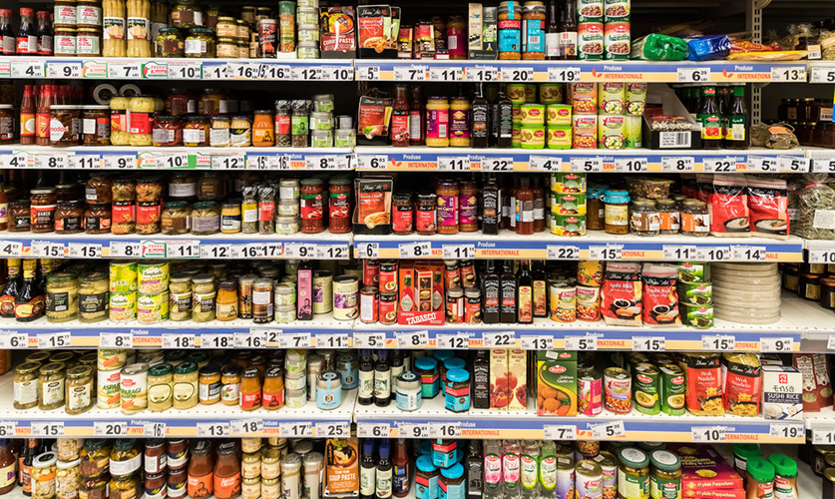
AGENDA
GUEST SPEAKER - Rainer Hillermann !
Motivation / Review
What is Regularization?
Why use Regularization
Lab
Discussion

Slide 4
HOMEWORK
Two parts of the Homework related to this lesson
Homework 2 - Chapter 6 of Introduction to Statistical Learning, Linear Model Selection and Regularization
Task list - Data Robot Article, Regularized Linear Regression with scikit-learn
DATA SCIENCE - Week 4 Day 1

Slide 5
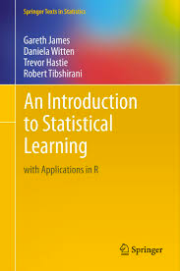

REGULARIZATION
Describe 3 ways we can select what features to use in a model?
Why would we use regularization?

Slide 6
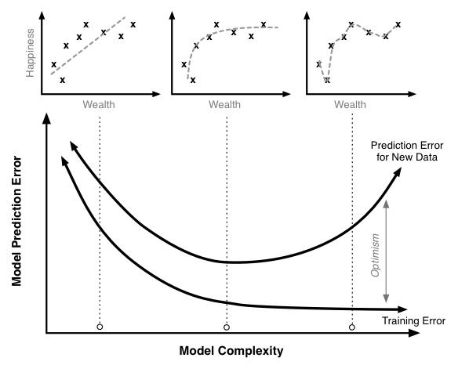
BIAS - VARIANCE TRADEOFF

Slide 7
SUBSET SELECTION
We could fit a separate linear regression model for every combination of our features.
But what happens when we have a large number of features?
Computation time becomes a factor and we also need to consider that as we include more features we are increasing the chance we include a variable that doesn’t add any predictive power for future data.

Slide 8
HOW DOES REGULARIZATION WORK?
A tuning parameter lambda (or sometimes alpha) imposes a penalty on the size of coefficients.
Instead of minimizing the "loss function" (mean squared error), it minimizes the "loss plus penalty".
A tiny alpha imposes no penalty on the coefficient size, and is equivalent to a normal linear model.
Increasing the alpha penalizes the coefficients and shrinks them toward zero.

Slide 9
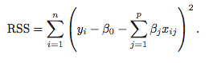
REGULARIZATION
Recall from Week 2 that the least squares procedure estimates coefficients that minimise
Regularization (or Shrinkage) is a way to constrain the estimates of beta to be close or equal to zero.

Slide 10
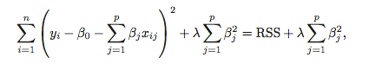
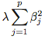
RIDGE REGRESSION
Ridge Regression is similar to least squares, except we include a penalty term,
the λ term is a tuning parameter. When it is zero we get least squares,
as it increases the term, (the shrinkage penalty) has more of an
impact and the coefficients will approach zero.

Slide 11
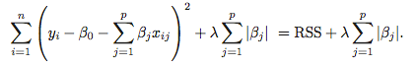
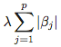
LASSO REGRESSION
Lasso Regression is similar to Ridge Regression, except we have the absolute value of beta in our penalty term,
the λ term is a tuning parameter. When it is zero we get least squares,
as it increases the term, (the shrinkage penalty) has more of an
impact and the coefficients will equal zero.

Slide 12
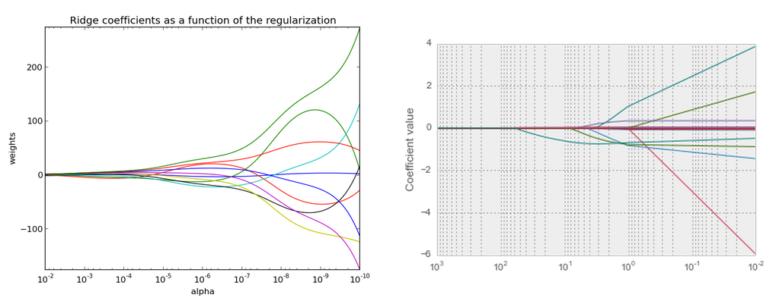
RIDGE VS LASSO

Slide 13
REGULARIZATION
Lasso regularization is useful if we believe many features are irrelevant, since a feature with a zero coefficient is essentially removed from the model. Thus, it is a useful technique for feature selection.

Slide 14
AGENDA
GUEST SPEAKER - Rainer Hillermann !
Motivation / Review
What is Regularization?
Why use Regularization
Lab
Discussion

Slide 15
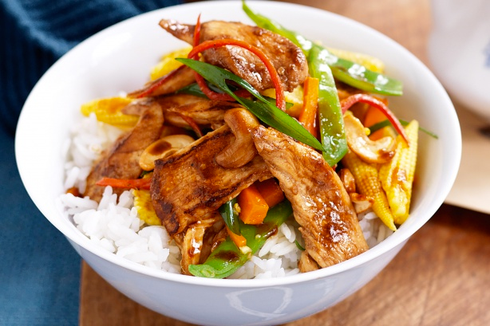
AGENDA
GUEST SPEAKER - Rainer Hillermann !
Motivation / Review
What is Regularization?
Why use Regularization
Lab
Discussion

Slide 16

LAB
DATA SCIENCE PART TIME COURSE

Slide 17
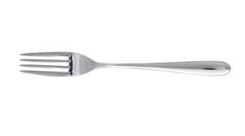
SYNCHING A FORK
git remote -v
git remote add upstream https://github.com/ihansel/SYD_DAT_3.git
git remote -v
git fetch upstream
git checkout master
git merge upstream/master
OR git reset --hard upstream/master

Slide 18
WEEK 4

Slide 19
READINGS
Read the following before class on Monday
Clustering Methods in Introduction to Statistical Learning, Chapter 10.3 (15 pages)
Python Notebook on Clustering http://nbviewer.ipython.org/github/nborwankar/LearnDataScience/blob/master/notebooks/D1.%20K-Means%20Clustering%20-%20Overview.ipynb
DATA SCIENCE - Week 4 Day 1

Slide 20
DISCUSSION TIME
Free scope. Anything you would like to talk about? Can be anything, e.g.
Software
News Articles
Things you’d like to cover in the course
Things you’ve been thinking about trying out
DATA SCIENCE - Week 4 Day 1

